Slide 1
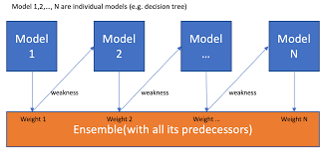
Boosting Algorithm
The boosting algorithm assigns equal weight to each data sample. It feeds the data to the first machine model, called the base algorithm. The base algorithm makes predictions for each data sample.

Slide 2
Types of Boosting algorithms
1) AdaBoost (Adaptive Boosting) algorithm
2)Gradient Boosting algorithm
3)XG Boost algorithm
4) CatBoost
5)Lightboost

Slide 3
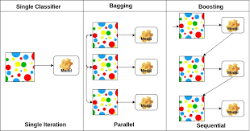
AdaBoost (Adaptive Boosting) algorithm.
1)Transforming weak leaves into strong leaves
2)By giving incremental weight concepts
3)User for class for classification and regression

Slide 4
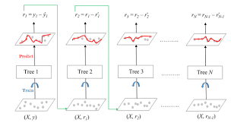
Gradient Boosting algorithm.
1)Model improves sequentially but not incremental weight concept
2)Optimize the loss function previous leaves
3)Additive model regularize loss function

Slide 5
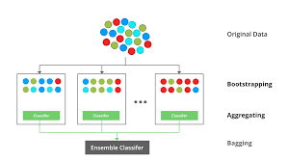
XG Boost algorithm.
1)Distributed machine learning process
2)More computational speed and model efficiency
3)Gradient boosting sequentially low

Slide 6
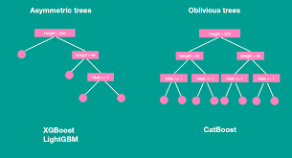
CatBoost.
Cat boosting good with categorical data
Various statistics and numerical functions

Slide 7
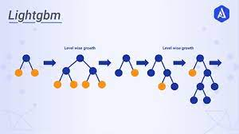
Lightboost
Large amount of data easy handle
Poor is small dataset
It was listrogram_based method

